Slide 2
SHIGELLOSIS
Dr Majid Asgharzadeh

Slide 3
ETIOLOGY
family Enterobacteriaceae
gram-negative bacilli
facultative aerobic
Somatic antigen (or O antigen) side chains that determine serotype and serogroup
nonmotile they lack the H antigen[flagellar]
four species or subgroups
(A, B, C, and D)
43 serotypes
A as S. dysenteriae
B as S.flexneri
C as S. boydii
D as S. sonnei

Slide 4
In developed countries
Shigella sonnei 85%
Shigella flexneri 14%
Shigella boydii, 1%
other species less than 1%
resource-limited countries pattern is reversed
S flexneri 66%
S dysenteriae
S. sonnei 24%
Notes:
Infections attributable to S flexneri, S boydii, and S dysenteriae are slightly more common among adults than among children; however, infections attributable to S sonnei in the United States predominate among both children and adults.

Slide 5
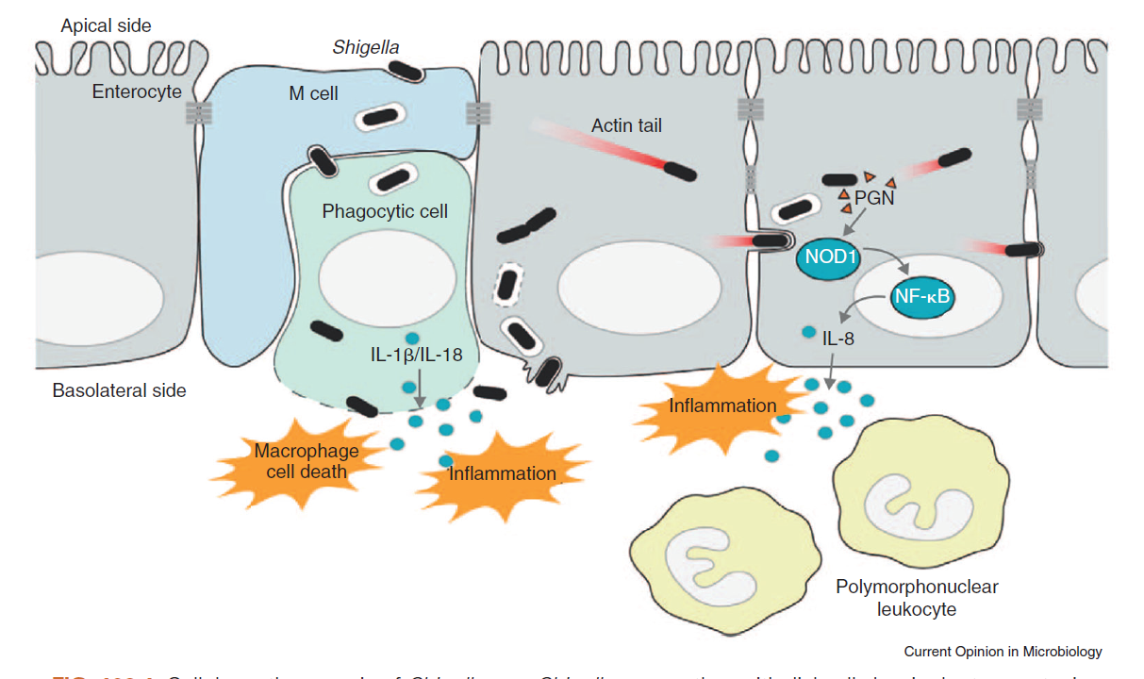
PATHOGENESIS
Main steps of colonic infection
Adhesion
Invasion
Intracellular Replication
Cell-to-cell Spread
Apoptosis is induced in macrophages
after ingestion of shigellae

Slide 6
Virulence Factors
genetic basis of virulence
molecular apparatus called a type III secretion system (T3SS)
capable of injecting bacterial proteins through bacterial and host membranes into host cells (translocation)
the extracellular milieu (secretion) to influence host biochemistry and cell physiology directly

Slide 7
A chromosomal locus in S. dysenteriae serotype 1 encodes a Protein Synthesis-inhibiting Exotoxin (Shiga toxin, Stx) that is a major virulence factor
Plesiomonas shigelloides
hypothesized to protect populations with poor water supplies against S. sonnei

Slide 8
EPIDEMIOLOGY
Humans are the natural host
fecal-oral route
via contact with a contaminated inanimate object
ingestion of contaminated food or water
sexual contact
Houseflies also may be vectors
10 organisms
Prolonged organism survival
water (up to 6 months)
food (up to 30 days)

Slide 9
incubation period varies
from 1 to 7 days
ranges from 12 hours to a few days
but typically is 1 to 3 days

Slide 10
Risk Factors for Severe Disease
Infants and adults >50 y
Children who are not breastfed
Children recovering from measles
Patients with HIV
Malnourished children and adults
Any patient who develops
dehydration,
unconsciousness
hypothermia or hyperthermia
history of convulsion with first seen

Slide 11
Increased Risk Of Infection
Children 5 years or younger
child care settings
crowded conditions
Men who have sex
Travel to resource-limited countries
inadequate sanitation

Slide 12
CLINICAL MANIFESTATIONS
primarily infect the large intestine
Onset of high fever, toxicity, and crampy abdominal pain is sudden and typically precedes the onset of diarrhea.
During the first 48 hours, high-volume watery diarrhea may occur (small bowel phase of disease); subsequently, low-volume, bloody, and mucous diarrhea develops in association with urgency and tenesmus (large bowel or “dysenteric” disease)

Slide 13
clinical manifestations range
from
watery or loose stools
with minimal or no constitutional symptoms
to
more severe symptoms, including
high fever,
abdominal cramps or tenderness,
tenesmus,
mucoid stools
with or without blood

Slide 14
approximately half of children do not develop bloody diarrhea during the course of their disease
The presence of only watery diarrhea does not exclude the possibility of shigellosis, especially in an ill patient with high fever

Slide 15
Septicemia
by Shigella organisms or
by other gut flora
Neonates
malnourished children
people with S dysenteriae serotype 1 infection but may occur in healthy children with nondysenteriae
shigellosis
Generalized seizures
self-limited
associated with high fever or electrolyte abnormalities
Reactive arthritis
HLA-B27
rare
weeks or months after

Slide 16
Shigella dysenteriae serotype 1
often causes a more severe illness than other shigellae with a higher risk of complications
septicemia
pseudomembranous colitis
toxic megacolon
Intestinal perforation
HUS
rare in industrialized countries

Slide 17
Physical examination shows
fever
signs of toxicity
tenderness over the lower abdominal quadrants
hyperactive bowel sounds
Rectal prolapse may be present, particularly when diarrhea is associated with malnutrition

Slide 18
Children with Shigella encephalopathy have significantly higher case-fatality rates than children with shigellosis without encephalopathy.
The pathogenesis of neurologic signs and symptoms during episodes of shigellosis is unclear.
Hypoglycemia an electrolyte abnormalities are found in a few patients.
Direct invasion of the central nervous system during Shigella bacteremia is very rare.

Slide 19
Severe toxic encephalopathy EKIRI SYNDROME
described in Japan
Dysentery with hyperpyrexia
convulsions
sensory disturbances
rapid progression to death.
Mild hyponatremia
The children died of cerebral edema early in the course of disease
(6 to 48 hours after onset).
NOT have
sepsis
DIC
HUS
Severe dehydration
This toxic encephalopathy is rare.
pathogenesis is unclear.

Slide 20
HUS
Shiga toxin
a potent cytotoxin
produced by S dysenteriae serotype 1
small number of strains
S flexneri type 2a
S dysenteriae type 4,
S sonnei
HUS has not been associated with infections attributable to these serotypes

Slide 21
The course without therapy typically lasts 5 to 7days
many enteric infections exacerbate undernutrition, initiating a “viscous cycle” of diarrhea and undernutrition
Even without antimicrobial therapy, the
carrier state usually ceases within 1 to 4 weeks after onset of illness;
long-term carriage is uncommon and does not correlate with underlying intestinal dysfunction.

Slide 22
Complications of Shigellosis
Abdominal
Persistent diarrhea
Postdysenteric irritable bowel syndrome
Ileus, toxic megacolon, intestinal perforation
Protein-losing enteropathy, malnutrition
Surgical complications: intestinal perforation and obstruction, appendicitis,
intraabdominal abscesses
Neurologic
Seizures
Headache, lethargy, disorientation, hallucinations
Coma
Severe toxin encephalopathy or ekiri syndrome
Bacteremia
In malnourished children, young infants, and HIV-AIDS patients
Hemolytic-Uremic Syndrome
Only with Shigella dysenteriae serotype 1
Urogenital
Vulvovaginitis, urinary tract infections
Other
Conjunctivitis, keratitis, corneal ulcers
Reactive arthritis
Reiter syndrome
Hepatitis
Myocarditis

Slide 23
DIAGNOSTIC TESTS
sensitive for
colitis
not specific for shigellosis
presence of fecal lactoferrin
Fecal leukocytes
blood leukocyte count in patients with shigellosis often is normal
although leukopenia or leukocytosis may occur
A leukemoid reaction has been reported in 10% of patients infected with the Shiga bacillus

Slide 24
Plated lightly
MacConkey
xylose-lysine-deoxycholate,
Hektoen enteric agar
Isolation of Shigella organisms
feces specimens
rectal swab specimens
At least two different culture media
stool as soon as possible
main determinant of success in isolating
not survive in fecal specimens during transit,
transport media Cary-Blair
transported at 4°C. (can’t be transported to lab in 2 hrs)
Enrichment Broth Mediadoes not significantly impact isolation rates
selective agar plate
Recovery of
shigellae is easier early in the course of the disease
Heavier plating
more inhibitory Shigella-Salmonella medium

Slide 25
PCR
detection of multiple bacterial, viral, and parasitic pathogens including Shigella have high sensitivity
but may yield false-positive results
(eg, detecting nonviable organisms)

Slide 26
Serologic studies are not helpful in establishing the diagnosis
humoral antibodies develop after clinical recovery.
Serologic studies helpful in epidemiologic studies
differentiate Shigella from Escherichia species
Biochemical profiling
Serogrouping
mass spectrometry of cellular components

Slide 27
B/C Should done in
severely ill
immunocompromised
malnourished children

Slide 28
Thanks for your attention

